Slide 1
Object oriented analysis & design
CS3C015

Slide 2
UNIT- 5
Object Oriented Testing, Types of Testing, Quality Assurance Methods, Reusability, Reverse Engineering, Case Studies.

Slide 3
Object oriented testing
OOT is a software testing process that is conducted to test the software using object oriented paradigm like:
Encapsulation
Inheritance
Polymorphism
Note: classes will be tested.

Slide 4
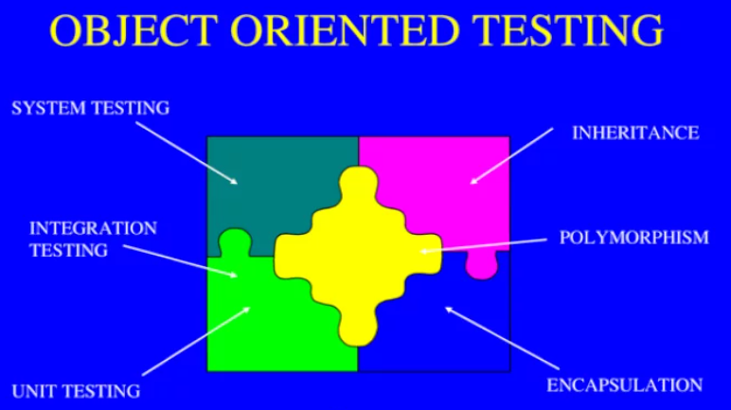

Slide 5
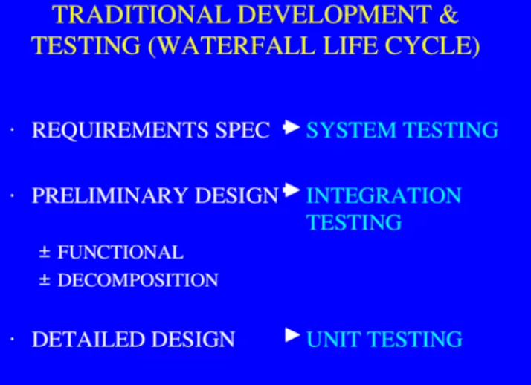

Slide 6
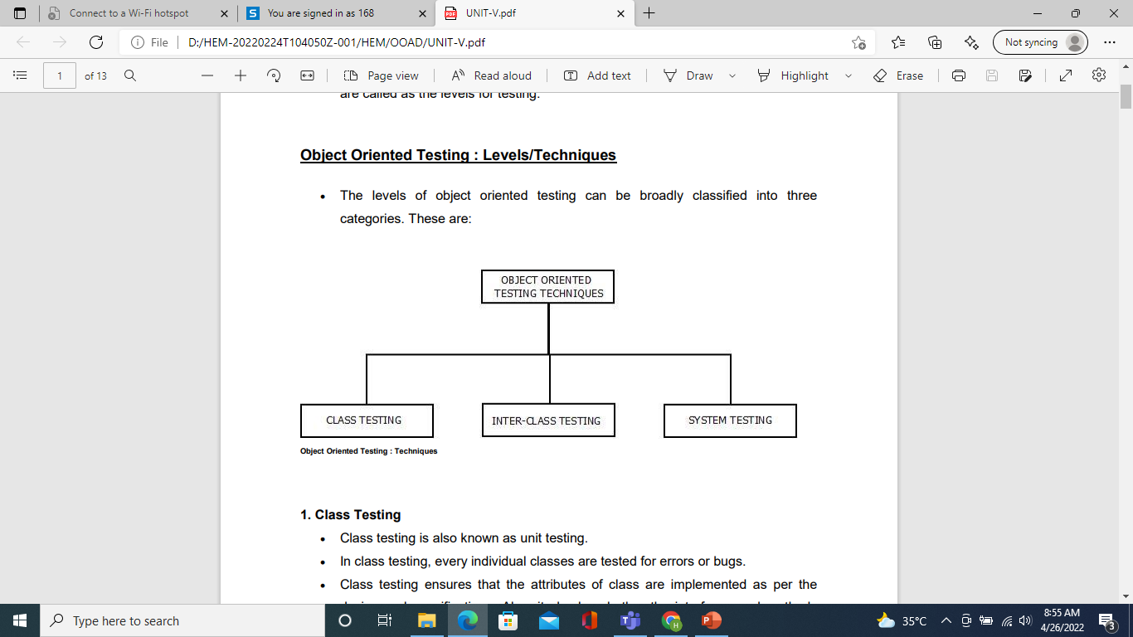

Slide 7
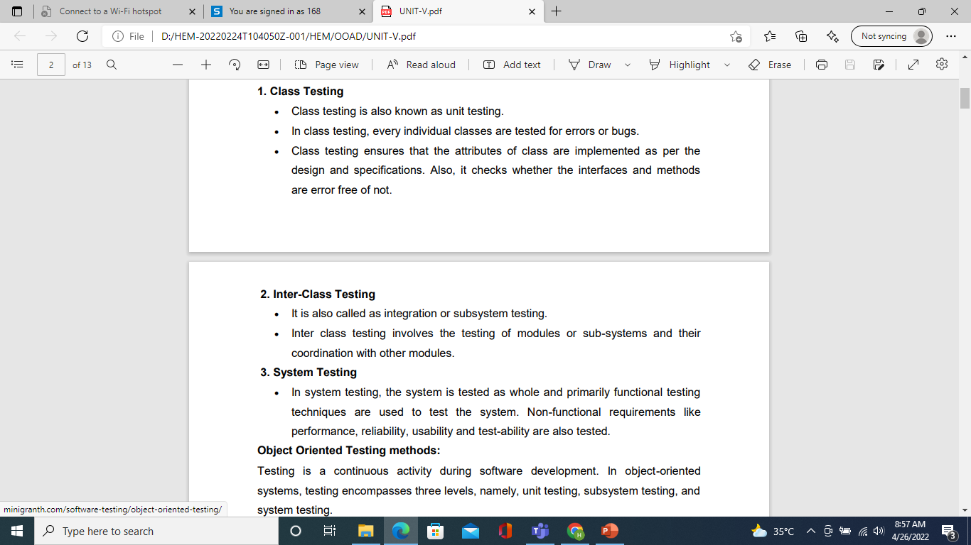

Slide 8
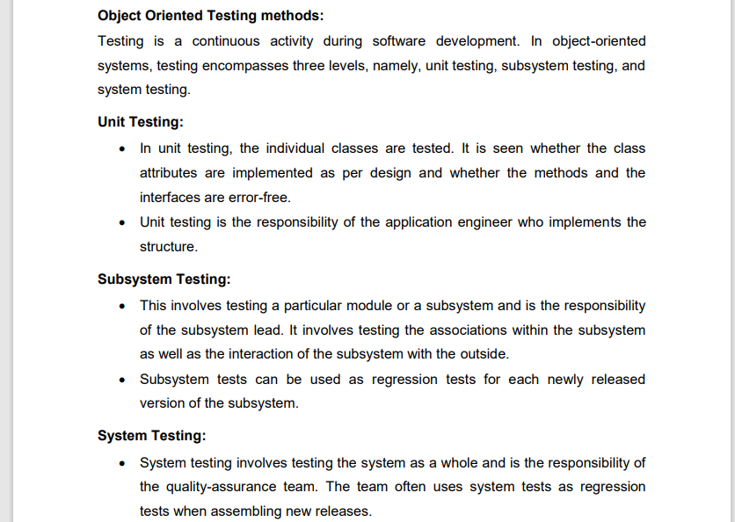

Slide 9
Testing Activities
Requirements
Analysis
Document
Subsystem
Code
Unit
Requirements
Analysis
Document
System
Design
Document
T
est
Tested
Subsystem
User
Manual
Subsystem
Code
Unit
T
est
Tested
Subsystem
Integration
Functional
Test
Test
Integrated
Subsystems
Functioning
System
Tested Subsystem
Subsystem
Code
Unit
T
est
All tests by developer
Cf. levels of testing

Slide 10
Testing Activities continued
Client’s
Understanding
of Requirements
Global
Requirements
User
Environment
Functioning
System
Validated
System
Accepted
System
Performance
Acceptance
Installation
Test
Test
Test
Usable
System
Tests by client
Tests by developer
User’s understanding
System in
Use
Tests (?) by user

Slide 11
NOTE:-
READ ALL THE TESTING EXPLAINED IN TESTING ACTIVITY

Slide 12
Developing test cases
It should be explicitly specified with each test case which class it should test.
Purpose of each test case should be mentioned.
External conditions that should exist while conducting a test should be clearly stated.
All the states of objects that is to be tested should be specified.
Instructions to understand and conduct the test cases should be provided with each test case.

Slide 13
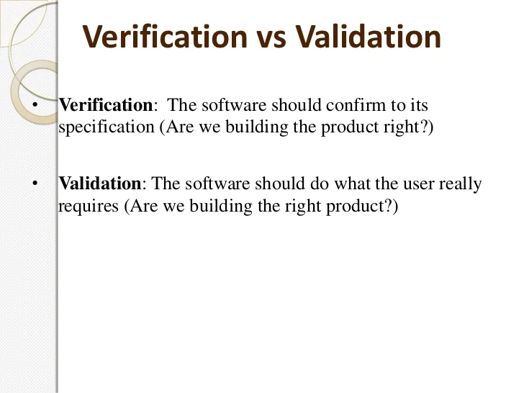
Verification and validation

Slide 14
verification
Verification in Software Testing is a process of checking documents, design, code, and program in order to check if the software has been built according to the requirements or not. The main goal of verification process is to ensure quality of software application, design, architecture etc. The verification process involves activities like reviews, walk-throughs and inspection.
Inspections
Reviews
Walkthroughs
Desk-checking

Slide 15
validation
Validation in Software Engineering is a dynamic mechanism of testing and validating if the software product actually meets the exact needs of the customer or not. The process helps to ensure that the software fulfills the desired use in an appropriate environment. The validation process involves activities like unit testing, integration testing, system testing and user acceptance testing.
Black box testing
White box testing
Unit testing
Integration testing

Slide 16
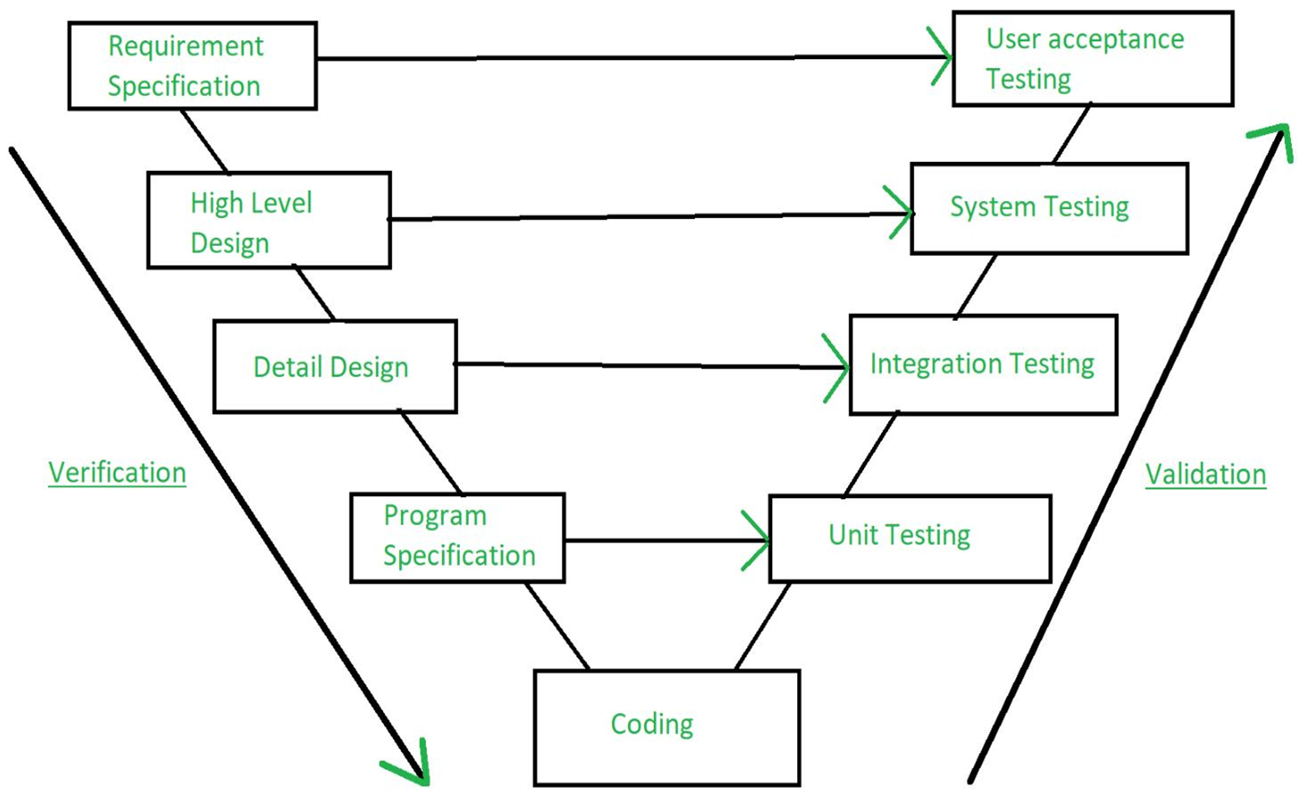

Slide 17
Verification | Validation
We check whether we are developing the right product or not. | We check whether the developed product is right.
Verification is also known as static testing. | Validation is also known as dynamic testing.
Verification includes different methods like Inspections, Reviews, and Walkthroughs. | Validation includes testing like functional testing, system testing, integration, and User acceptance testing.
It is a process of checking the work-products (not the final product) of a development cycle to decide whether the product meets the specified requirements. | It is a process of checking the software during or at the end of the development cycle to decide whether the software follow the specified business requirements.
Quality assurance comes under verification testing. | Quality control comes under validation testing.
The execution of code does not happen in the verification testing. | In validation testing, the execution of code happens.
In verification testing, we can find the bugs early in the development phase of the product. | In the validation testing, we can find those bugs, which are not caught in the verification process.
Verification testing is executed by the Quality assurance team to make sure that the product is developed according to customers' requirements. | Validation testing is executed by the testing team to test the application.
Verification is done before the validation testing. | After verification testing, validation testing takes place.
In this type of testing, we can verify that the inputs follow the outputs or not. | In this type of testing, we can validate that the user accepts the product or not.
Next Topic

Slide 18
Software quality
Quality is defined as a characteristics or attributes of something where as attributes refer to measurable characteristics-things that we are able to compare to known standards.
There are two kinds of quality:
Quality of design refers to the characteristics that designers specify for an item. The grade of materials, tolerances and performance specifications all contribute to the quality of design.
Quality of conformance is the degree to which the design specifications are followed during manufacturing. Greater the degree of conformance, the higher is the level of quality of conformance

Slide 19
Software quality
Software quality is defined as conformance to explicitly stated functional and performance requirements, explicitly documented development standards, and implicit characteristics that are expected of all professionally developed software.
“In the context of software engineering, software quality measures how well the software is designed (quality of design), and how well the software conforms to that design (quality of conformance). It is often described as the ‘fitness for purpose’ of a piece of software.”

Slide 20
Software quality
Example: Consider a functionally correct software product. That is, it performs all tasks as specified in the SRS document. But, has an almost unusable user interface. Even though it may be functionally right, we cannot consider it to be a quality product.

Slide 21
Software quality
It emphasize three points
Software requirements are the foundation from which quality is measured.
Specified standards define a set of development criteria.
Set of implicit requirement.

Slide 22
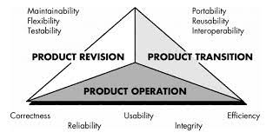
McCall’s Quality Factors(11)

Slide 23
Product operation
Correctness : The extent to which a program satisfies its specification and fulfils the customers mission objectives
Reliability : The extent to which a program can be expected to perform its intended function with required precision
Usability : The effort required to learn , operate , prepare input for and interpret output of a program
Integrity : The extent to which access to software or data by unauthorized person can be controlled
Efficiency : The amount of computing resources and code required by a program to perform its function.

Slide 24
Product revision
Maintainability : The effort required to locate and fix an error in a program
Flexibility : The effort required to modify an operational program
Testability : The effort required to test a program to ensure that it performs its intended function

Slide 25
Product transition
Portability : The effort required to transfer the program from one hardware and/or software system environment to another
Reusability : The extent to which a program can be reused in other application related to the packaging and scope of the functions that the program performs
Interoperability : The effort required to couple one system to another

Slide 26
assurance
Assurance is nothing but a positive declaration on a product or service, which gives confidence. It is certainty of a product or a service, which it will work well. It provides a guarantee that the product will work without any problems as per the expectations or requirements.

Slide 27
Software Quality Assurance(SQA)
Software quality assurance (SQA ) is defined as a procedure to ensure the quality of software products or services provided to the customers by an organization. Quality assurance focuses on improving the software development process and making it efficient and effective as per the quality standards defined for software products.
is an umbrella activity that is applied throughout the software process.

Slide 28
Sqa
SQA encompasses:
A quality management approach
Effective software engineering technology
Formal technical reviews
Multi-tier testing strategy
Control of software documentation and the changes made to it
A procedure to ensure compliance with software
development standards
Measurement and reporting mechanism

Slide 29
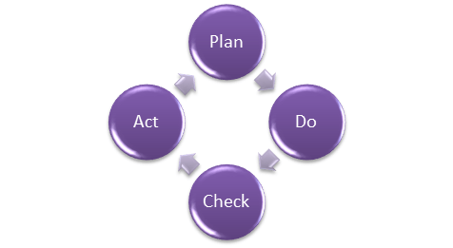
How to do Quality Assurance:
Quality Assurance methodology has a defined cycle called PDCA cycle or Deming cycle. The phases of this cycle are:
Plan
Do
Check
Act

Slide 30
How to do Quality Assurance:
Plan – Organization should plan and establish the process related objectives and determine the processes that are required to deliver a high-Quality end product.
Do – Development and testing of Processes and also “do” changes in the processes
Check – Monitoring of processes, modify the processes, and check whether it meets the predetermined objectives
Act – A Quality Assurance tester should implement actions that are necessary to achieve improvements in the processes

Slide 31
Quality Assurance vs. Quality control
Quality Assurance | Quality Control
Quality Assurance (QA) is the set of actions including facilitation, training, measurement, and analysis needed to provide adequate confidence that processes are established and continuously improved to produce products or services that conform to specifications and are fit for use. | Quality Control (QC) is described as the processes and methods used to compare product quality to requirements and applicable standards, and the actions are taken when a nonconformance is detected.
QA is an activity that establishes and calculates the processes that produce the product. If there is no process, there is no role for QA. | QC is an activity that demonstrates whether or not the product produced met standards.
QA helps establish process | QC relates to a particular product or service
QA sets up a measurement program to evaluate processes | QC verified whether particular attributes exist, or do not exist, in a explicit product or service.
QA identifies weakness in processes and improves them | QC identifies defects for the primary goals of correcting errors.
Quality Assurance is a managerial tool. | Quality Control is a corrective tool.
Verification is an example of QA. | Validation is an example of

Slide 32
Sqa approaches
Defect management approach
Quality attribute approach

Slide 33
Software Quality Defect Management Approach
The defect management approach works by counting and managing defects. Defects encompass a large range of errors from poor data handling to bad code.
In defect management, once your development team has identified a defect, they assign it a category given the severity of the defect. Then, the team takes specific actions to address the counted defects.
Usually, such an approach operates best with clear and concise control charts to measure and improve development process capability. Process capability determines how well processes manage to meet standards.

Slide 34
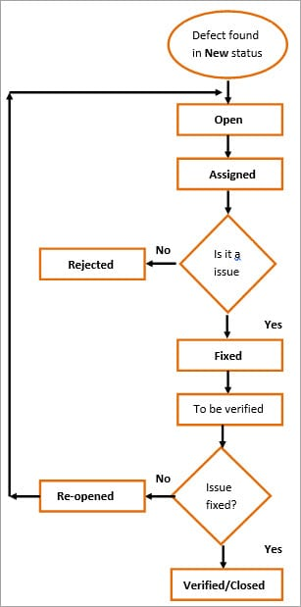

Slide 35
Software Quality Attributes Approach
The quality attributes approach directs attention to a number of quality characteristics. Depending on who you ask, there are between six and a dozen or more of these characteristics.
This is likely because some attributes overlap or fall under one another. For instance, suitability is a matter of functionality. And usability extends learnability.

Slide 36
Software Quality Attributes Approach
That said, just these six basic attributes will cover what you need to know for the moment:
Functionality
Reliability
Usability
Efficiency
Maintainability
Portability

Slide 37
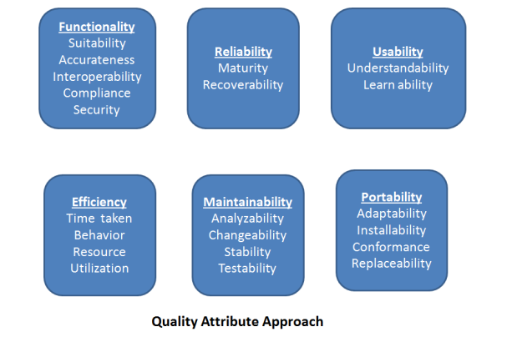

Slide 38
Benefits of sqa
SQA produce high quality software.
High quality application saves time and cost.
SQA is beneficial for better reliability.
SQA is beneficial in the condition of no maintenance for long time.
High quality commercial software increase market share of company.
Improving the process of creating software.
Improves the quality of the software.

Slide 39
Reusability in ooad
The ability to reuse relies in an essential way on the ability to build larger things from smaller parts, and being able to identify commonalities among those parts. ... Reusability implies some explicit management of build, packaging, distribution, installation, configuration, deployment, maintenance and upgrade issues.

Slide 40
What is the purpose of reusability?
Reusability is a major contributor to the development goal of achieving high speed, low cost and quality. Usually, it is better and faster to employ proven off-the-shelf designs rather than specially-crafted designs that might have problems.

Slide 41
What is reusability in Ooad?
Reusability is the use of existing assets in some form within the software product development process. Assets are products and by products of the software development life cycle and include code, software components, test suites, designs and documentation.
Why is reusability important in Ooad?

Slide 42
Why is reusability important in Ooad?
In object-oriented systems, assessing reusability plays a key role in reducing a cost and improving the quality of the software. Objectoriented programming helps in achieving the concept of reusability through different types of inheritance programs, which further help in developing reusable software modules.

Slide 43
What is reuse software engineering?
Reuse software engineering is based on guidelines and principles for reusing the existing software.
What are stages of reuse-oriented software engineering?
Requirement specification:
First of all, specify the requirements. This will help to decide that we have some existing software components for the development of software or not.
Component analysis
Helps to decide that which component can be reused where.

Slide 44
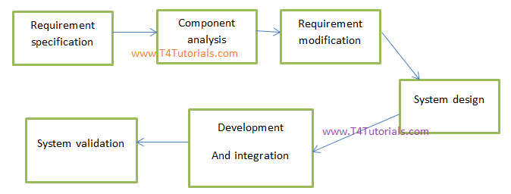
Stages of reuse-oriented software engineering

Slide 45
Stages of reuse-oriented software engineering
Requirement updations / modifications. -If the requirements are changed by the customer, then still existing components are helpful for reuse or not.
Reuse System design-If the requirements are changed by the customer, then still existing system designs are helpful for reuse or not.
Development-Existing components are matching with new software or not.
Integration-Can we integrate the new systems with existing components?
System validation-To validate the system that it can be accepted by the customer or not.

Slide 46
Software Reverse Engineering
Software Reverse Engineering is a process of recovering the design, requirement specifications and functions of a product from an analysis of its code. It builds a program database and generates information from this.
The purpose of reverse engineering is to facilitate the maintenance work by improving the understandability of a system and to produce the necessary documents for a legacy system.

Slide 47
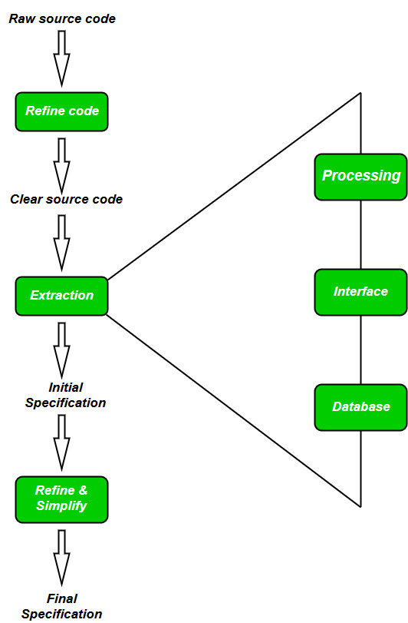
Reverse Engineering Goals:
Cope with Complexity.
Recover lost information.
Detect side effects.
Synthesise higher abstraction.
Facilitate Reuse.

Slide 48
Steps of Software Reverse Engineering:
Collection Information:
This step focuses on collecting all possible information (i.e., source design documents etc.) about the software.
Examining the information:
The information collected in step-1 as studied so as to get familiar with the system.
Extracting the structure:
This step concerns with identification of program structure in the form of structure chart where each node corresponds to some routine.
Recording the functionality:
During this step processing details of each module of the structure, charts are recorded using structured language like decision table, etc.

Slide 49
Steps of Software Reverse Engineering:
Recording data flow:
From the information exA tracted in step-3 and step-4, set of data flow diagrams are derived to show the flow of data among the processes.
Recording control flow:
High level control structure of the software is recorded.
Review extracted design:
Design document extracted is reviewed several times to ensure consistency and correctness. It also ensures that the design represents the program.
Generate documentation:
Finally, in this step, the complete documentation including SRS, design document, history, overview, etc. are recorded for future use.

Slide 50
Thank you

